Slide 1


Weather Trend Forecasting
- Uttam Kumar P

Slide 2
PM Accelerator Mission
By making industry-leading tools and education available to individuals from all backgrounds, we level the playing field for future PM leaders. This is the PM Accelerator motto, as we grant aspiring and experienced PMs what they need most – Access. We introduce you to industry leaders, surround you with the right PM ecosystem, and discover the new world of AI product management skills.

Slide 3

Data cleaning and preprocessing
Grouping the data based on country and location name, if the count is lower than 25th percentile, they are dropped.
Nulls and duplicates are checked, however there are no nulls and updates.
Last updated is converted to datetime.
Featured engineered columns like year, month, day, hour, day of week.

Slide 4
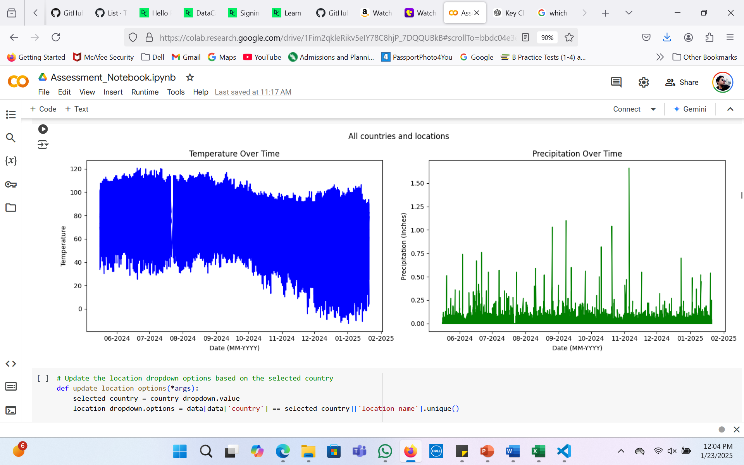
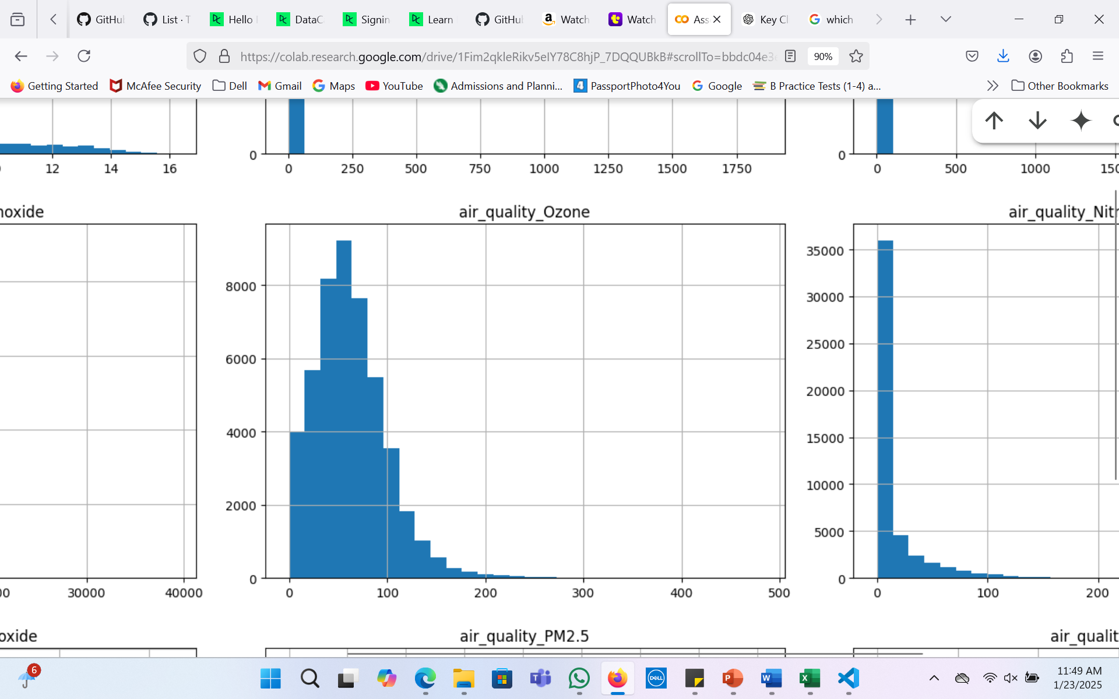
EDA
Following key factors are responsible for climate change: temperature, precipitation, ozone quality.
As temperature influences evaporation rates hence, it can affect the precipitation rates, which can eventually affect climate.
Sunny hot days often result due to increasing ground level ozone concentrations.

Slide 5
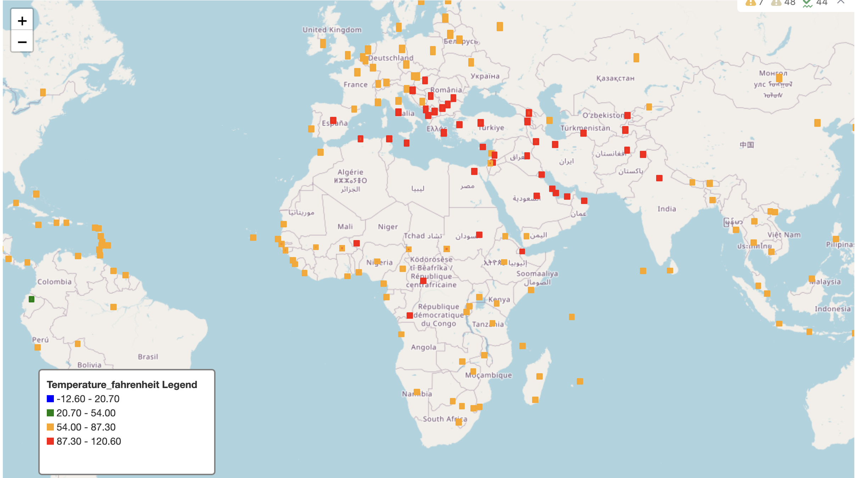
Temperature across countries.
It shows how all the factors have impacted the temperature differently across countries.

Slide 6
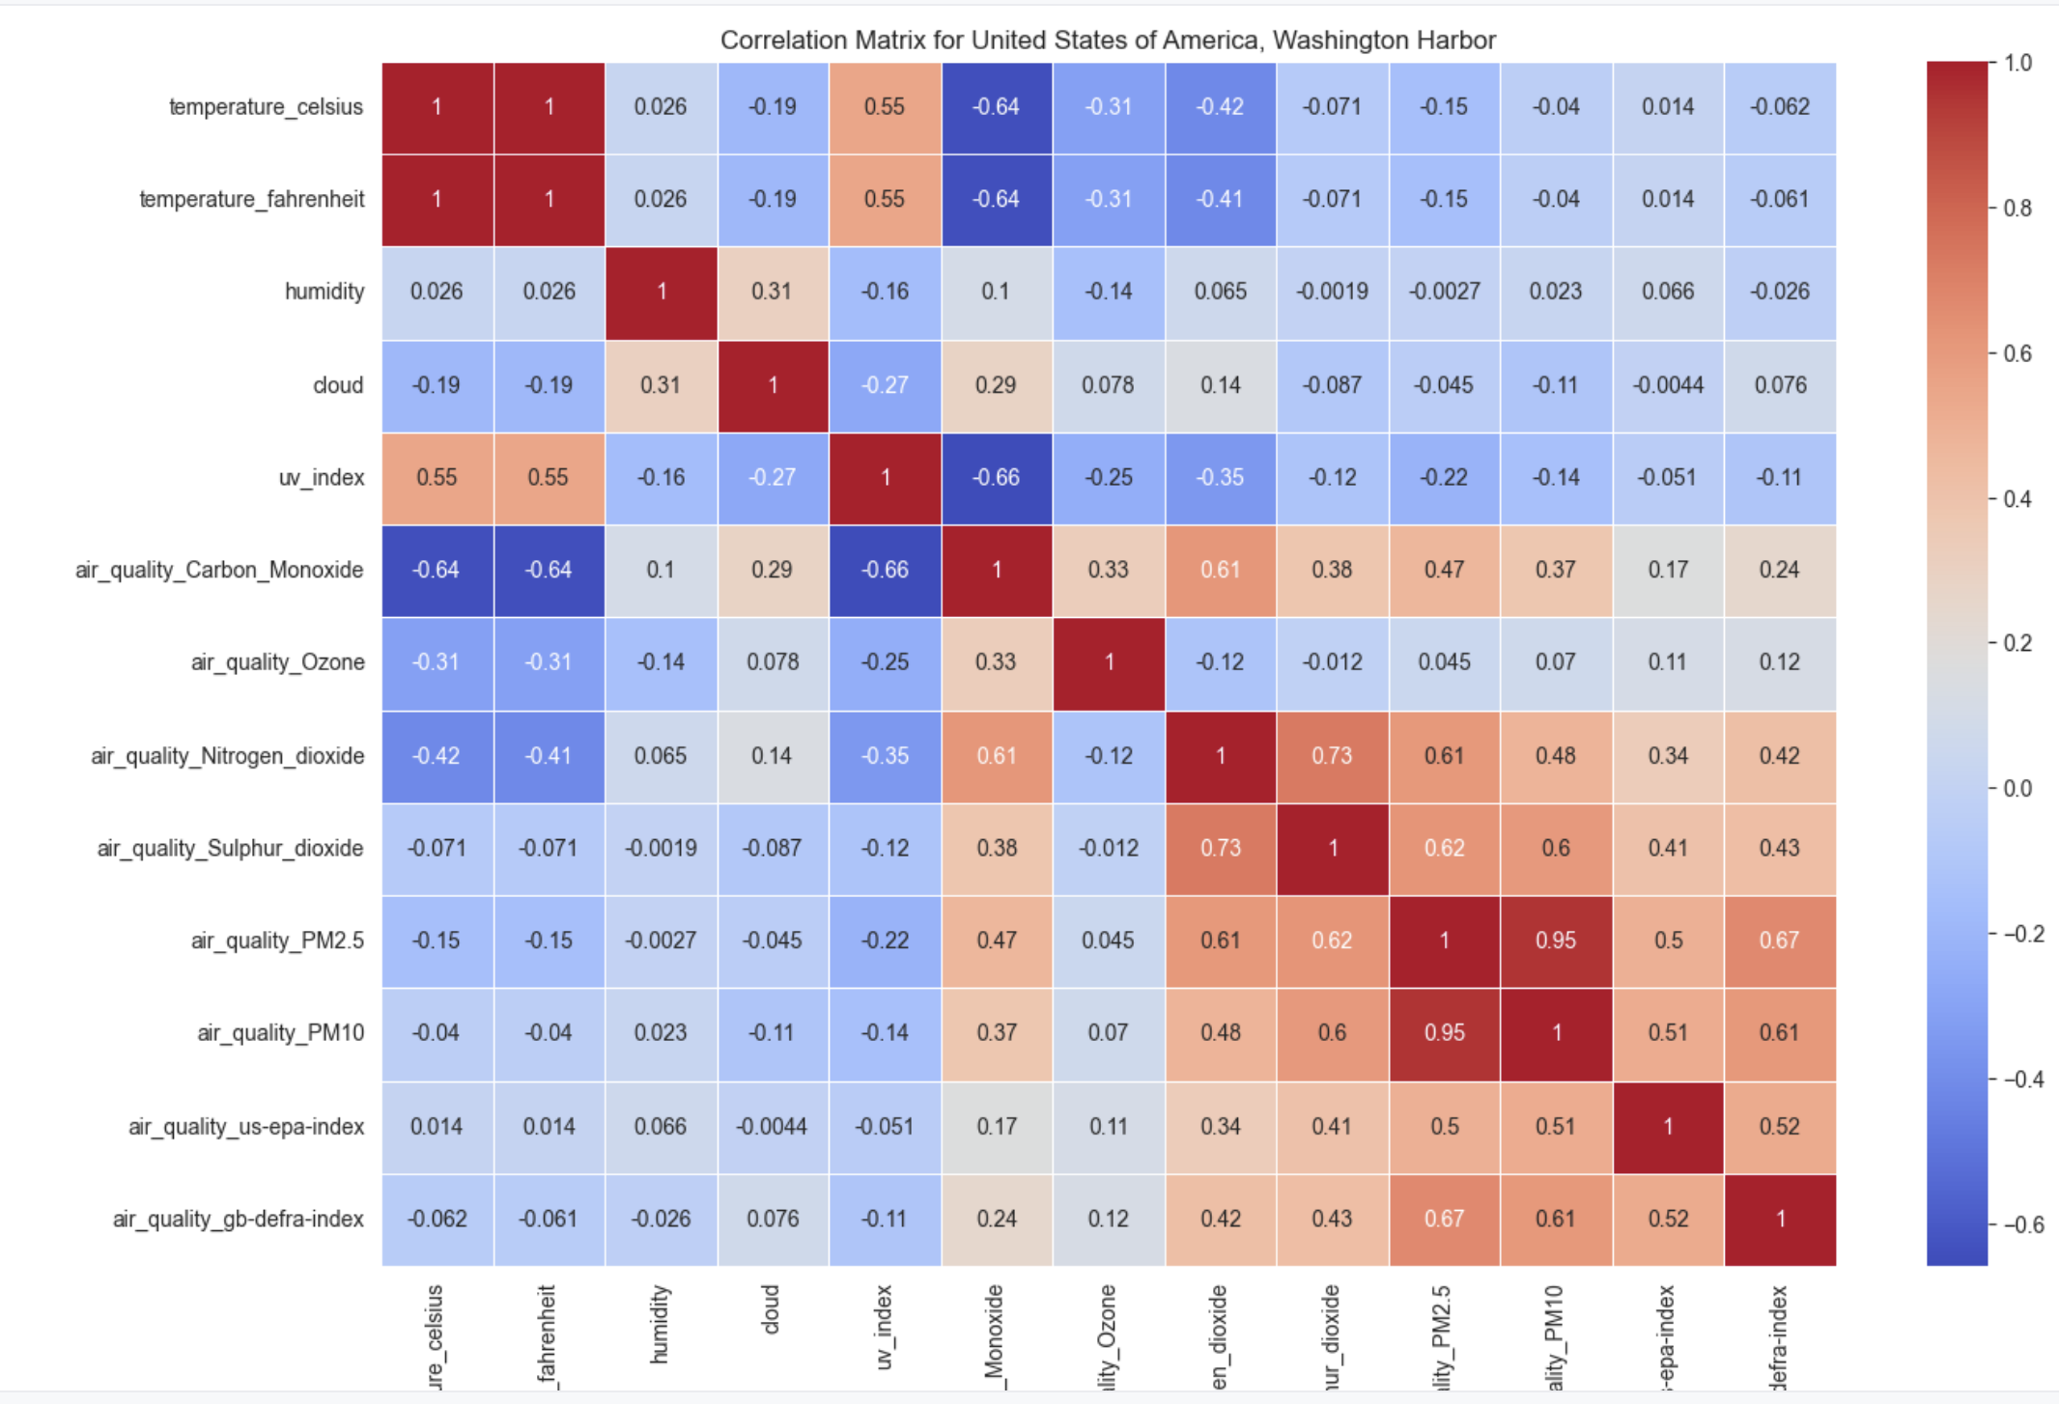
Correlation Matrix
UV index, is highly correlated with temperature fahrenheit.
Hence, governments and climate change organizations around the world should focus on controlling the factors that are responsible for UV index, so that temperature can be maintained, according the human friendly needs.

Slide 7
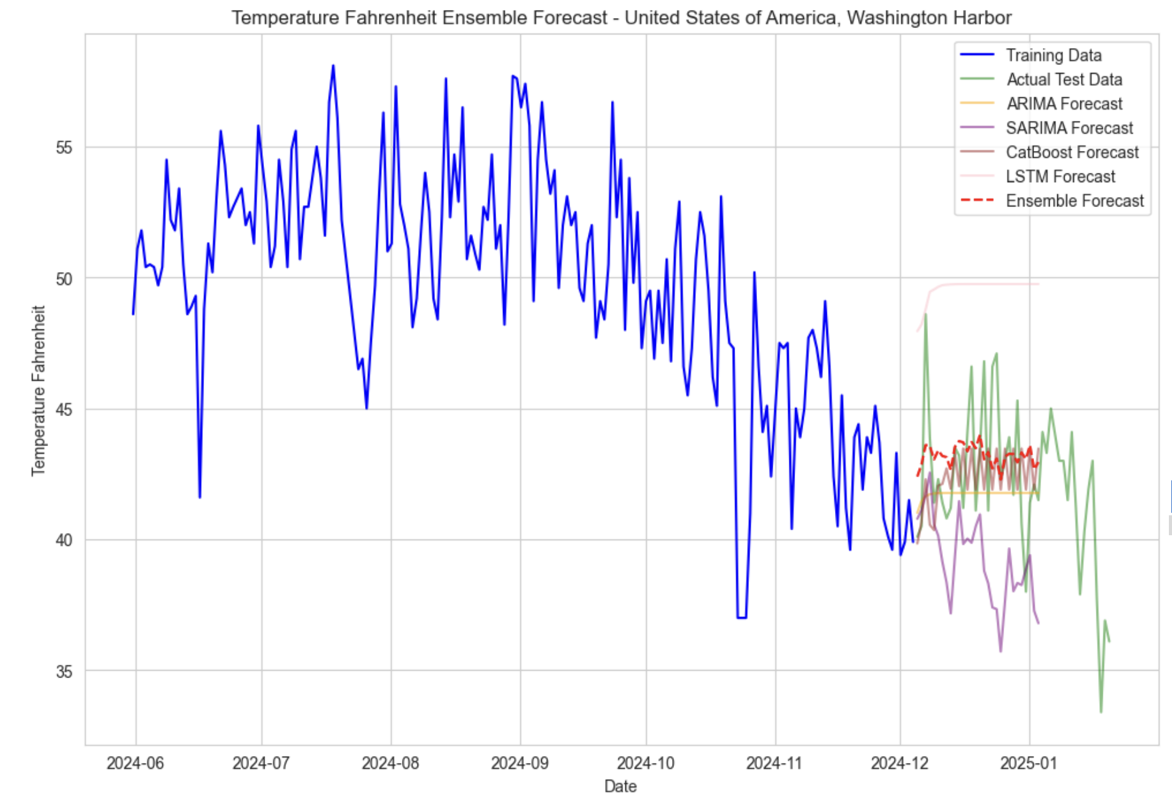
Model Comparison
Model | MSE
ARIMA | 6.3096
SARIMA | 21.1203
CatBoost | 9.9805
LSTM | 30.6157
Ensemble | 5.7055

Slide 8
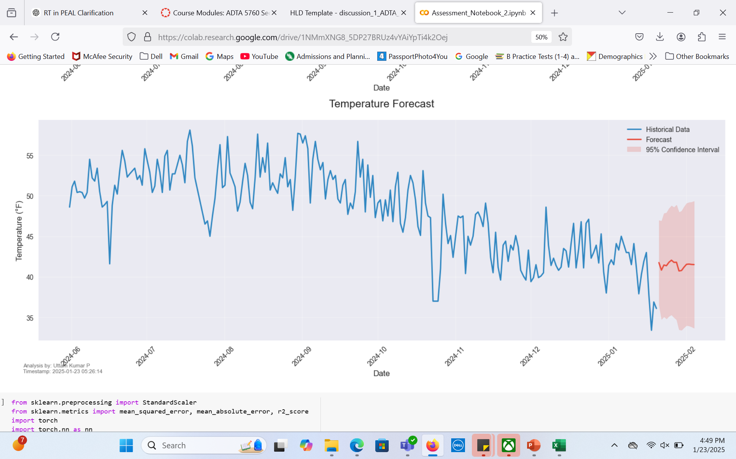
Forecasting model with exogenous features included.
Exogenous features are variables other than target variables (temperature) which are important outside the times series which can influence the climate.
RMSE= 2.97`F
With SARIMX, predictions with 95% confidence interval.

Slide 9
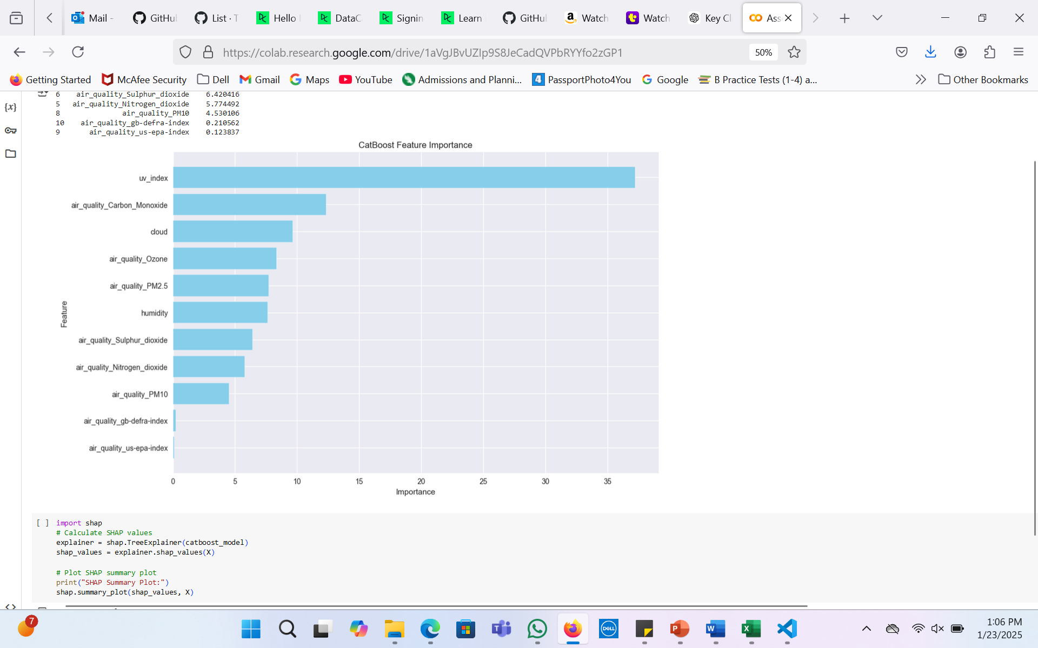
CatBoost Regression and Feature Importance
UV_index and air_quality_carbon_monoxide are most significant features that contribute in temperature in Fahrenheit.

Slide 10
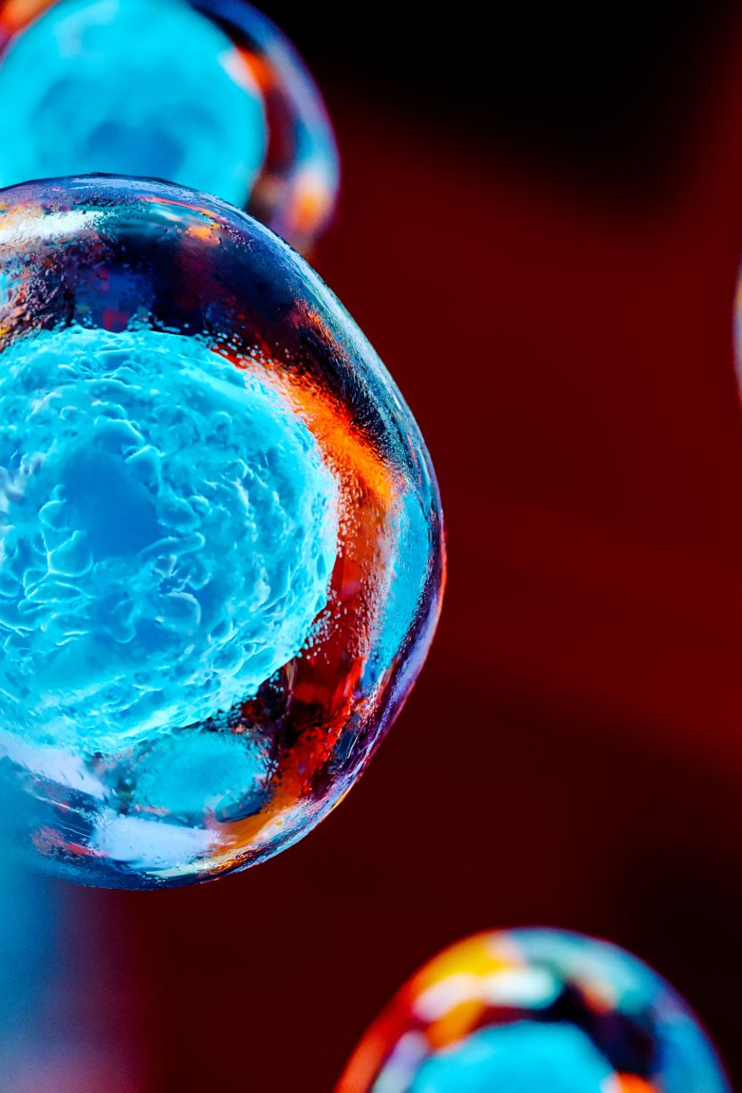
Conclusion
Ultraviolet skin damaging radiation is the serious factor that is responsible for increase in the temperature.
After the analysis, it is recommended that Government and Environmental agencies should emphasis on reducing gas emissions, such as: Sulphur dioxide, Nitrogen dioxide, and carbon mono oxide, because in our analysis we found that these gases are highly contributing to increasing the temperature.

